Slide 1
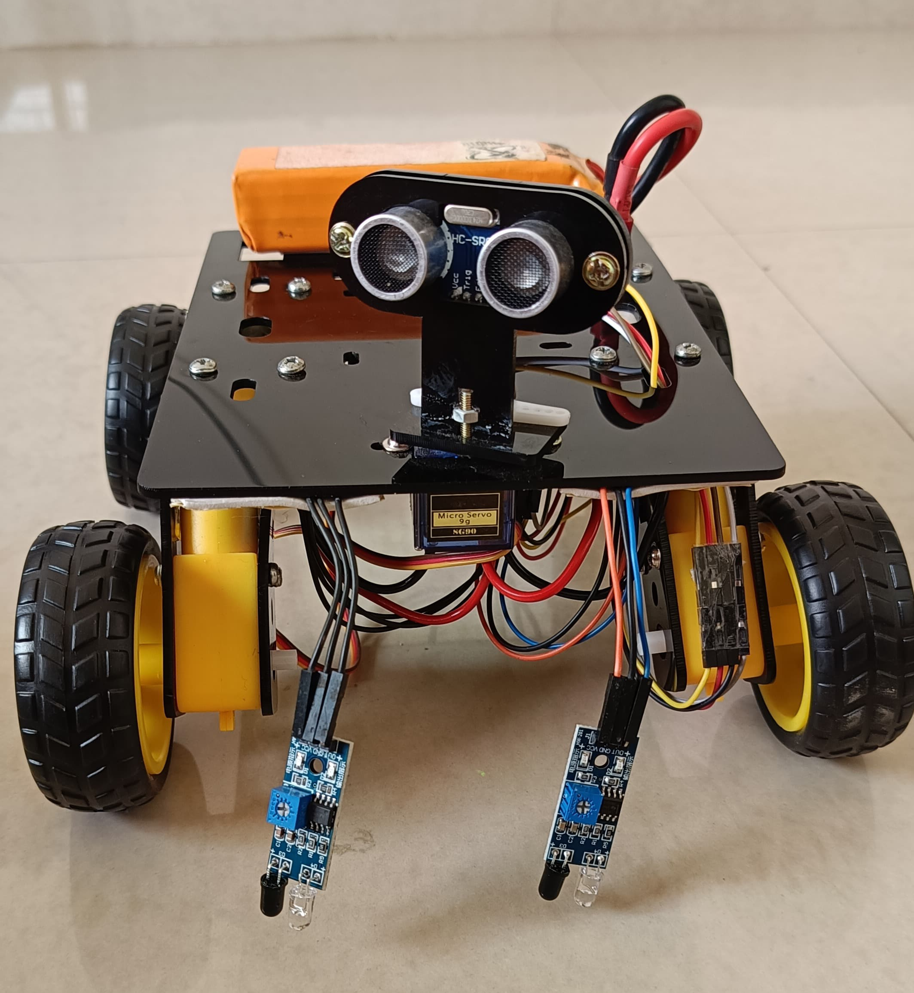
TRACK MASTER ROBOT

Slide 2
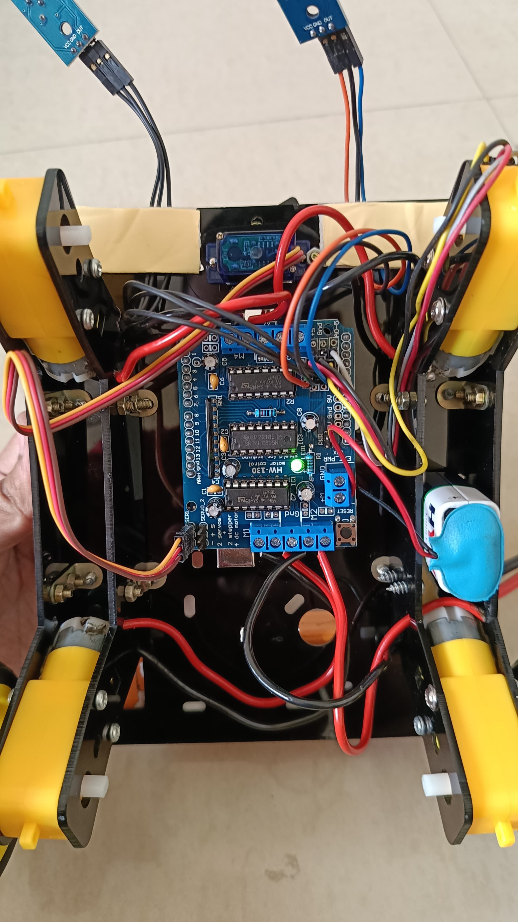
COMPONENTS
Chassis
Motors
Arduino Uno
Motor Shield
Ultrasonic Sensor
Infrared Sensor
Servo Motor
Drone Battery

Slide 3
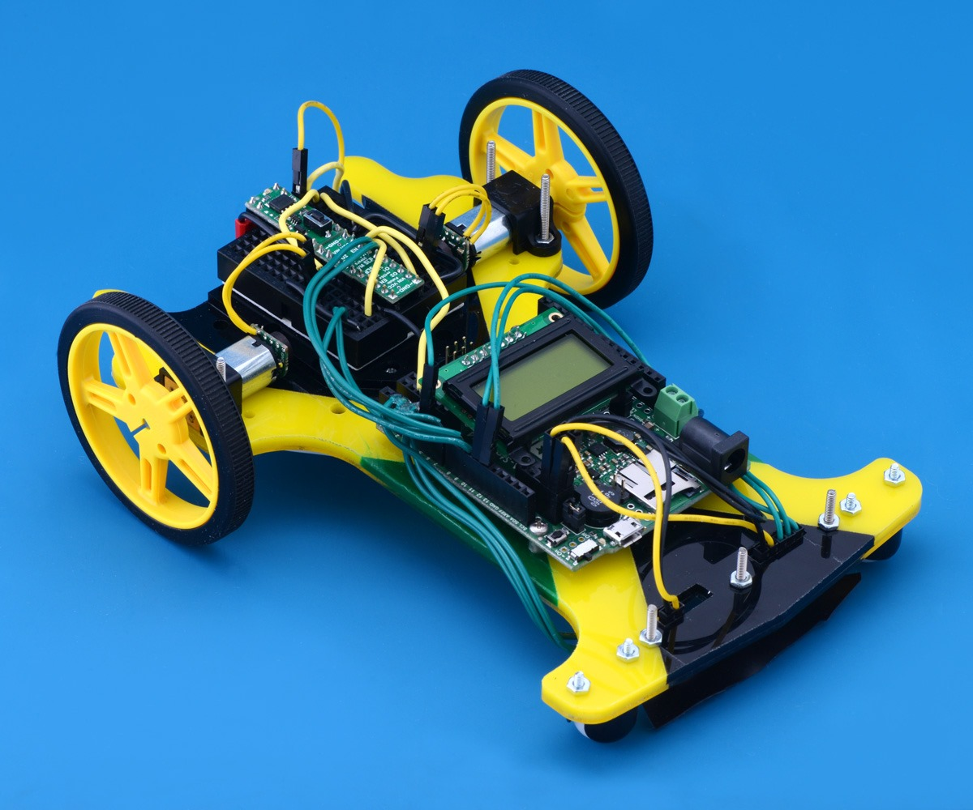
01.
CHASSIS
the chassis is the framework or structure of the robot that holds its components together. It provides the mechanical support and protection for the internal components of the robot.

Slide 4
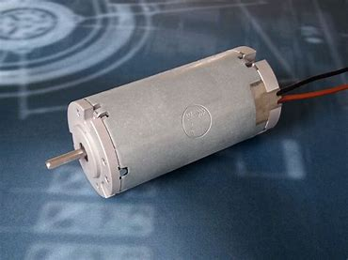
02.
MOTORS
A DC (Direct Current) motor is a type of electric motor that converts electrical energy into mechanical motion. DC motors are widely used in various applications due to their simplicity, ease of control, and versatility.

Slide 5
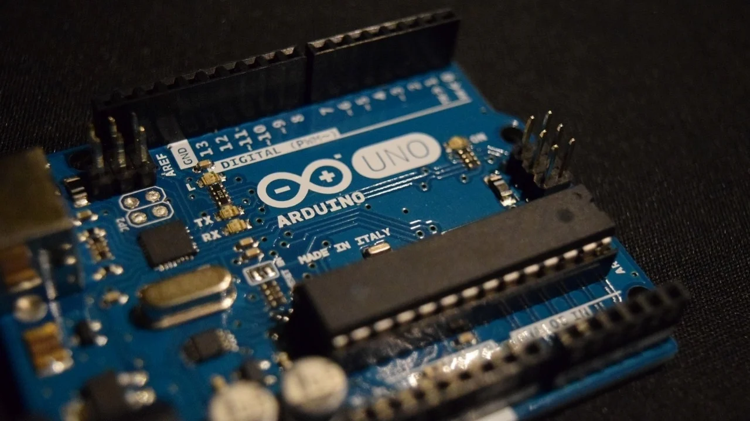
03.
ARDUINO UNO
The Arduino Uno is a popular open-source microcontroller board based on the ATmega328P microcontroller. It is a part of the Arduino family of boards and is widely used for prototyping and DIY electronics projects..

Slide 6
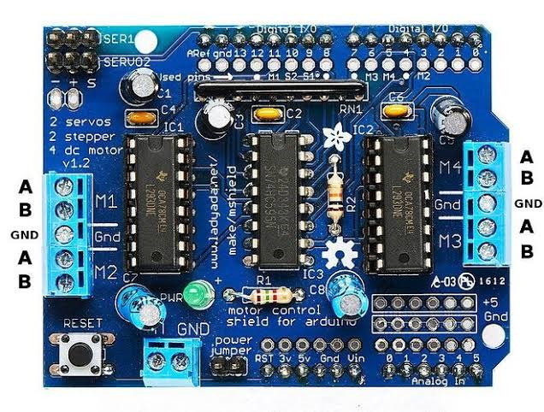
04.
MOTOR SHIELD
A motor shield is an expansion board or module designed to simplify the process of controlling motors with a microcontroller like Arduino.

Slide 7
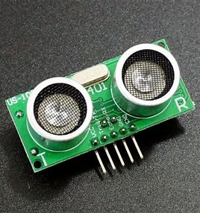
05.
ULTRASONIC SENSOR
An ultrasonic sensor is a device that uses ultrasonic sound waves for distance measurement and object detection.

Slide 8
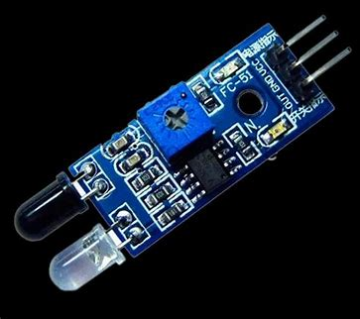
06.
INFRARED SENSOR
An Infrared (IR) sensor is a device that uses infrared radiation to detect the presence or absence of an object, or to measure its distance

Slide 9
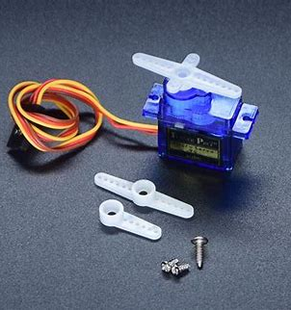
07.
SERVO MOTOR
A servo motor is a rotary or linear actuator that allows for precise control of velocity and acceleration. It is a closed-loop system that uses feedback to ensure that the motor reaches and maintains its desired position.

Slide 10
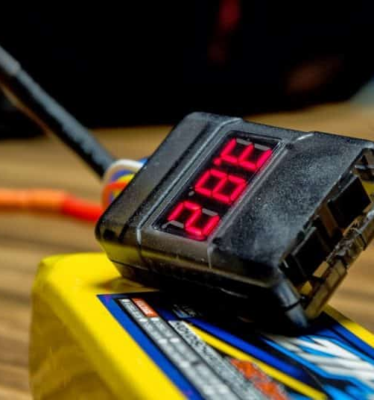
08.
DRONE BATTERY
Drone batteries are lithium-polymer (LiPo) batteries, are typically designed for higher voltage and power requirements compared to what a typical line-following robot might need.

Slide 11
WORKING PRINCIPLE
According to the above circuit diagram, we notice that a microcontroller (Atmega328p) is used to communicate with the whole system for processing the robotics functions. First, we need to connect both Vcc and ground pins of the Arduino Uno with a 9V power supply. As we know this is the main source for operating the whole system. After connecting the above connection, let’s connect the motor shield onto the Arduino UNO. The ultrasonic sesnsor detects objects on the path with the help of servo motor and finds the correct route to dodge the object.

Slide 12
Four geared motors are connected to the outer terminal of the motor driver as shown in the circuit diagram. This is a powerful motor driver that can drive four 6V motors easily. After that, let’s connect the right infrared sensor’s data pin to the A0 pin and the left infrared sensor’s data pin to the A1 pin of the Arduino. It helps to detect the black line according to the robot’s path and let it rotate in the correct direction.

Slide 13
Applications:
Environmental Monitoring
Entertainment
Security and Surveillance:
Tracking animal migrations or monitoring environmental parameters.
Robot races and exhibitions. They can be customized for fun and amusement.
Patrol predefined routes in sensitive areas, such as airports, to enhance security and surveillance

Slide 14
Hospital and Healthcare
Retail
Agriculture
Line-following robots can guide customers to specific products.
Transport medications, samples, and other supplies between different departments.
Planting, weeding, and harvesting crops.

Slide 15
THANKS
-AARYAN DHAWAN-22070122002
-ABHISHEK RAJPUT-22070122007
-ANISH CHOUDHARY-22070122016
-ARNAV JAIN-22070122030
-ARNAV KHANDELWAL-22070122031

